Slide 1
Evaporation & Vapour Pressure
Learning Intentions:
• Use the Kinetic Theory of Matter to explain
- relationship between heat and temperature
- change of phase
- vapour pressure and factors that affect vapour pressure
• Explain the effect of concentration on vapour pressure, melting point and boiling point of a solution.
• Explain and describe the interaction between solute and solvent particles in a solution.

Slide 2
States of Matter
Think of all the molecules as having some amount of energy that allows them to vibrate. Intermolecular forces are only broken when these vibrations move the particles far away enough. Until the distance is great enough, they stay together.

Slide 3
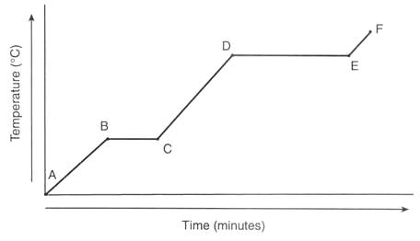
Transition of States

Slide 4
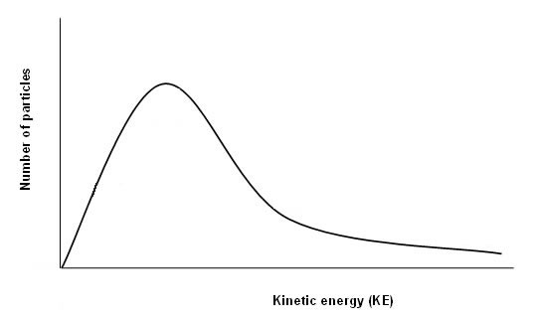
Vapour Pressure
The change of state between liquid and gas is very important as it involves a large increase in the kinetic energy of the particles: it can take a lot of energy to cause evaporation to occur. This is why evaporative air conditioners cool our homes and sweat cools our skin.
To understand boiling we first need to understand the idea of vapour pressure. Some vapour will be present above the surface of any liquid because some of the more energetic particles will have enough kinetic energy to escape from the liquid and become a gas. Remember that even at low temperatures there will be some particles with high kinetic energy. Below is a graph showing the distribution of energies of particle within a liquid.
Maxwell-Boltzmann Distribution

Slide 5
Vapour Pressure
The presence of these extra gas particles that have been lost from the liquid will increase the air pressure above the liquid. This increase in pressure caused by the evaporating particles is called the 'vapour pressure'. This effect will mean that every liquid will have a vapour pressure, although for some it will be very low.
The temperature will affect the average kinetic energy of the particles in the liquid, which will affect the vapour pressure.
Therefore, when we compare vapour pressures, we have to state a fixed temperature.
Notes:
Increase

Slide 6
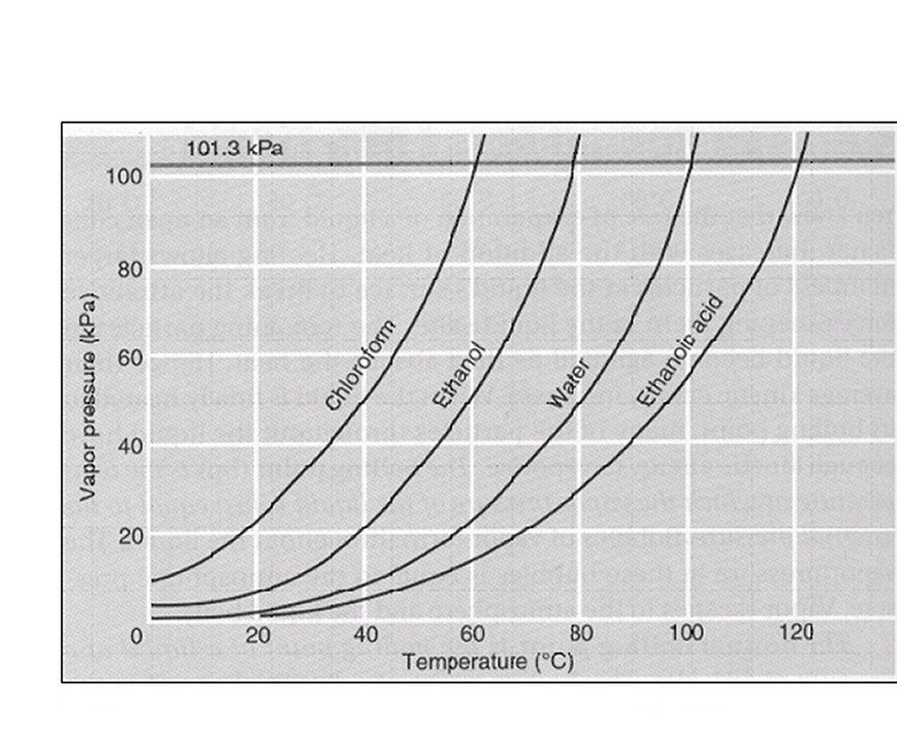
Vapour Pressures of Different Liquids

Slide 7
Transition of States
What is a boiling point?

Slide 8
How solvents affect solutions: Colligative properties
A colligative property is one that is determined by the concentration of dissolved particles in a solution.

Slide 9

Colligative Properties
Freezing point
The freezing point of pure water is 0 °C. When a solute is added to a solvent, the freezing point of the liquid is lowered. This makes it harder to freeze the liquid as you will have to cool it more before it freezes. This effect is used in car radiators when antifreeze (ethylene glycol) is added to the water to stop the water from freezing if the outside temperature drops to 0 °C.
In cold climates, salt can be spread on roads to help melt ice and snow, again because the salt is a solute and it lowers the freezing point of the water on the road.

Slide 10
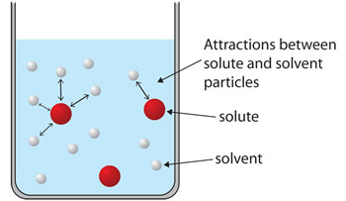
Colligative Properties
Vapour pressures and boiling points
When a solute dissolves in a solvent, there is an ION-DIPOLE attraction between the solute particles and the solvent particles. These attractions are stronger than the attractions between particles in the pure solvent.
This results in the following:
More_ENERGY_ is required to allow the particles to escape from the liquid. Evaporation will therefore be _SLOWER_ .
And with fewer particles above the liquid, the vapour pressure will be _LOWER_ , overall the _BOILING_ point will be increased.
Below are examples of the boiling points of solutions compared to pure water

Slide 11
Colligative Properties
 | Vapour pressure at 25 °C (kPa) | Boiling point (°C)
Pure water | 3.17 | 100
Sugar (sucrose) solution (1.0 mol L⁻¹) | 3.11 (Hydrogen bonding) | 100.5
Salt (NaCl) solution (1.0 mol L⁻¹) | 3.06 (ion-dipole) | 101

Slide 12
Questions
Read Chapter 1.1, 1.2, 1.3, 1.4, 1.5, 1.6 Lucarelli
Complete Questions from Set 1
Must – Q2,3,4,5,6,7,11,13
Should – Q8,9,10
Could – Q12

